Slide 1







International Spring School
Neustadt an der Weinstraße, Germany, March 10-14, 2025
Lab 1: Spherical harmonic synthesis
Marius Schlaak (TUM) & Grigorios Kalimeris (TUM)

Slide 2
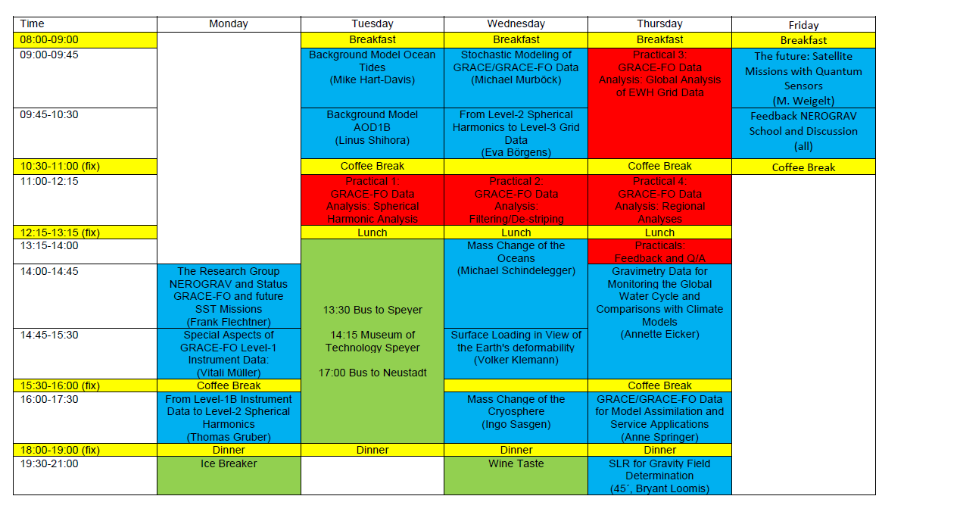
International Spring School Practicals
Four Practical Exercises on GRACE-FO Data Analysis:
Spherical Harmonic Analysis
Filtering/De-Striping
Global Analysis of EWH Grid Data
Regional Analysis

Slide 3
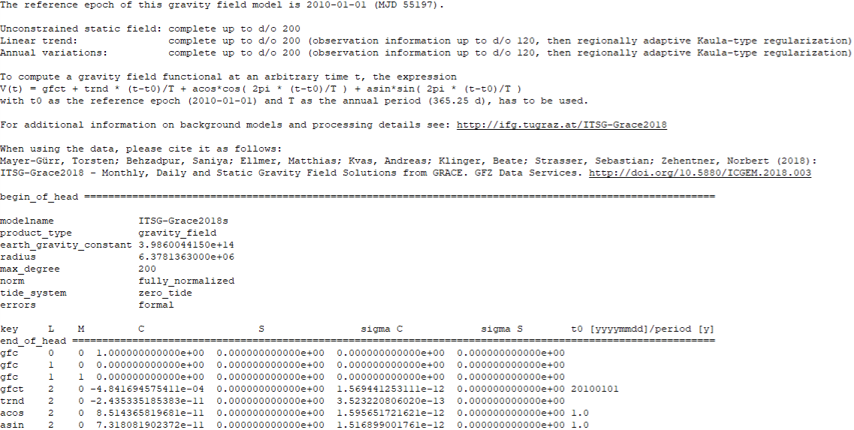
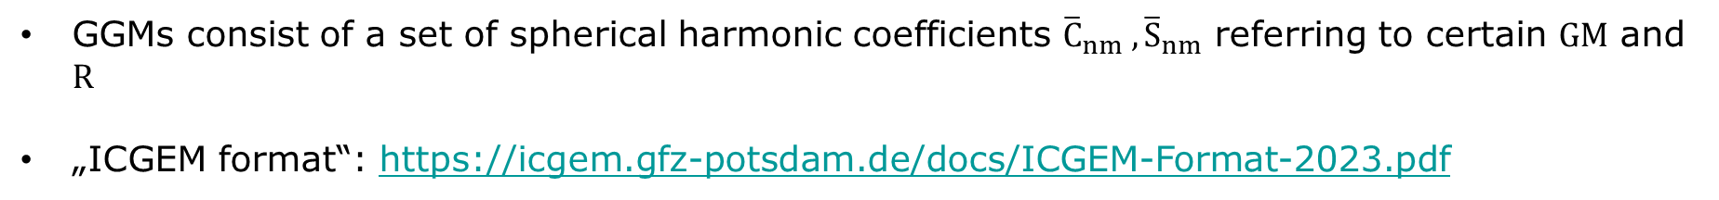
Global Gravity potential Models (GGMs)
GGMs consist of a set of spherical harmonic coefficients ${\overline{C}}_{nm} ,{\overline{S}}_{nm}$ referring to certain $GM$ and $R$
„ICGEM format“: https://icgem.gfz-potsdam.de/docs/ICGEM-Format-2023.pdf
Header section
Mandatory keywords
Static SH coefficients
t0 [yyyymmdd] : Reference epoch
Time variable
SH coefficients
period [y]
degree (L) order (M)
Spherical harmonic (SH) coefficients
standard deviation of
SH coefficients

Slide 4

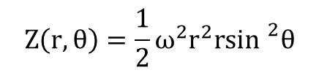
Gravity & Normal potential
Gravitational potential
  Gravity potential (gravity field model – “true” Earth): $W\left(r,θ,λ\right)=V+Z$
$$V\left(r,θ,λ\right)=\frac{GM_{Model}}{R_{Model}}\sum_{n=0}^{n_{max}}{{\left(\frac{R_{Model}}{r}\right)}^{n+1}\sum_{m=0}^{n}{{\overline{P}}_{nm}\left(\cos{θ}\right)\left[{\overline{C}}_{nm}\cos{mλ}+{\overline{S}}_{nm}\sin{mλ}\right]}}$$
Normal potential (reference ellipsoid – model Earth): $U\left(r,θ,λ\right)=V′+Z$
Centrifugal potential:
Maximum degree of model
Fully normalized associated Legendre polynomials (of degree n and order m)
Gravitational constant times
mass of the Earth
Radius of the sphere to which the SH series expansion of
the model refer
R_{Model} + observation altitude;
r=R_{Model} on sphere’s surface
Fully normalized SH coefficients (of degree n and order m)
= weighting of base functions
Normal gravitational potential
ω: angular velocity of the Earth’s rotation (precisely known quantity)
$$Z\left(r,θ\right)=\frac{1}{2}ω^{2}r^{2}r\sin^{2}θ$$
Common for both cases!
Notes:
• The geocentric coordinate r is called radial distance and is defined as the distance of the calculation point P from the geocenter.
• The geocentric coordinate θ is called colatitude (or polar distance) and is defined as the angle subtended between the position vector r and the Z-axis. The colatitude is reckoned clockwise from the Z-axis which is set as the colatitude reference of the geocentric spherical coordinates system.
• The geocentric coordinate λ is called longitude and is defined as the angle subtended between the projection of the position vector r onto the X-Y plane and the X-axis. The longitude is reckoned anticlockwise from the X-axis which is set as the longitude reference of the geocentric spherical coordinates system.

Slide 5
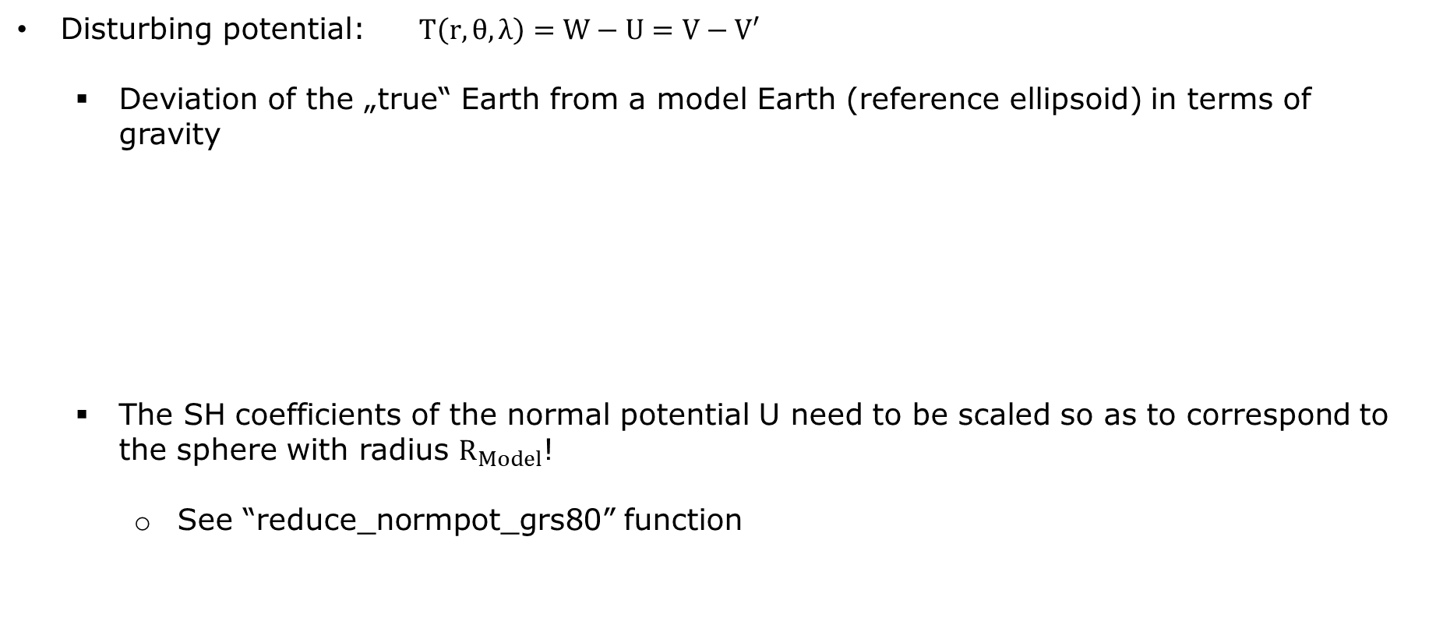

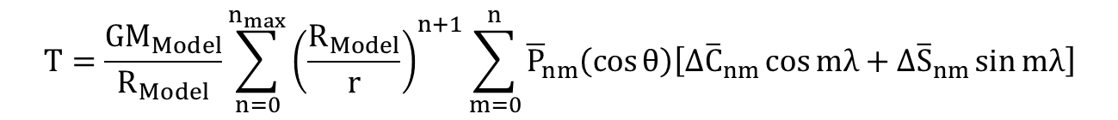
Disturbing potential
  Disturbing potential: $T\left(r,θ,λ\right)=W−U=V−V′$
    Deviation of the „true“ Earth from a model Earth (reference ellipsoid) in terms of gravity
    The SH coefficients of the normal potential U need to be scaled so as to correspond to the sphere with radius $R_{Model}$!
      See “reduce_normpot_grs80” function
$$T=\frac{GM_{Model}}{R_{Model}}\sum_{n=0}^{n_{max}}{{\left(\frac{R_{Model}}{r}\right)}^{n+1}\sum_{m=0}^{n}{{\overline{P}}_{nm}\left(\cos{θ}\right)\left[{∆\overline{C}}_{nm}\cos{mλ}+{∆\overline{S}}_{nm}\sin{mλ}\right]}}$$
Coefficient differences ($W vs U$)!

Slide 6
Gravity functionals
The disturbing potential constitutes the basis for the computation of various gravity field functionals
  Geoid heights
  Height anomaly
  Gravity disturbances
  Gravity anomalies
  Vertical deflections
  Gravity gradients
  …
Notes:
Can only be computed w.r.t. a defined geodetic reference system, e.g. the Geodetic Reference System 1980 (GRS80)

Slide 7
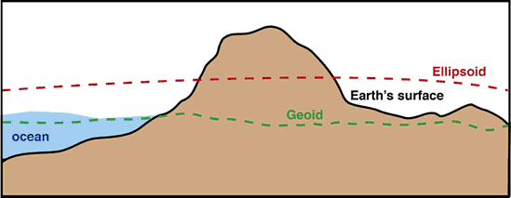
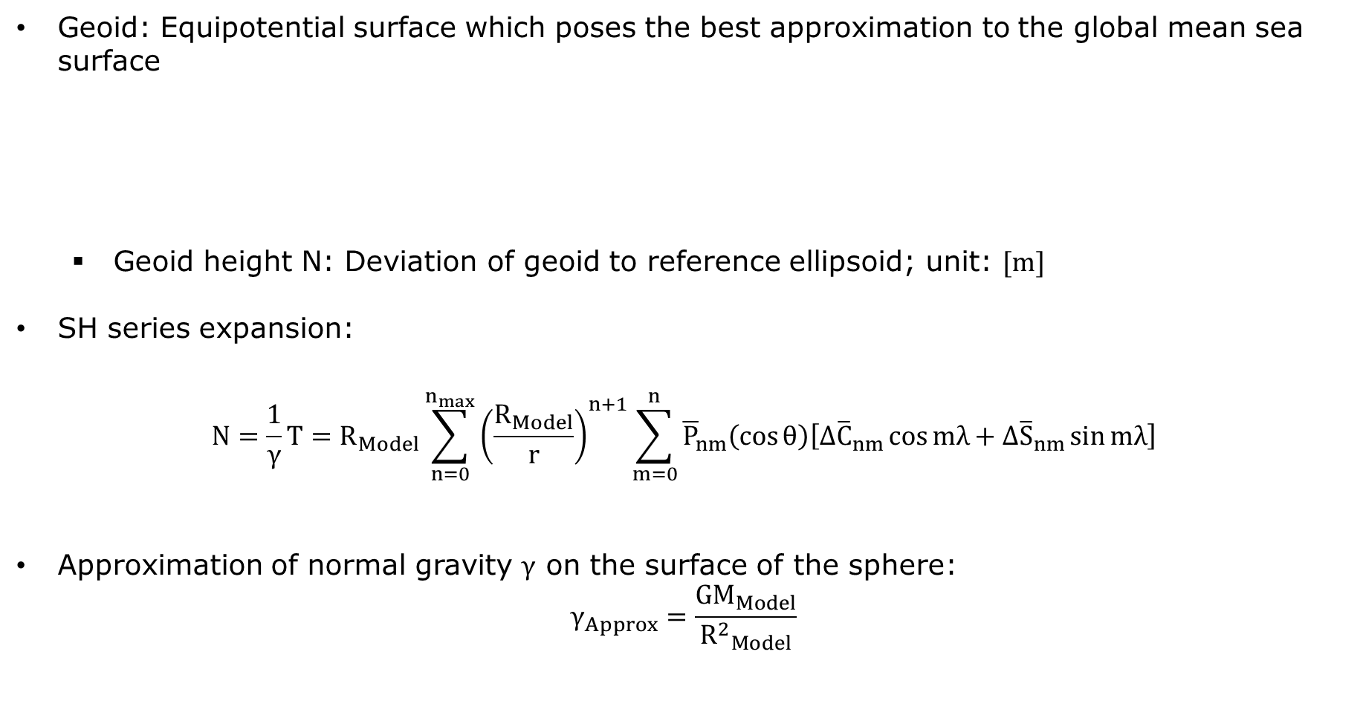
Geoid heights
Geoid: Equipotential surface which poses the best approximation to the global mean sea surface
  Geoid height N: Deviation of geoid to reference ellipsoid; unit: $[m]$
SH series expansion:
$$N=\frac{1}{γ}T=R_{Model}\sum_{n=0}^{n_{max}}{{\left(\frac{R_{Model}}{r}\right)}^{n+1}\sum_{m=0}^{n}{{\overline{P}}_{nm}\left(\cos{θ}\right)\left[{∆\overline{C}}_{nm}\cos{mλ}+{∆\overline{S}}_{nm}\sin{mλ}\right]}}$$
Approximation of normal gravity $γ$ on the surface of the sphere:
$$γ_{Approx}=\frac{GM_{Model}}{{R^{2}}_{Model}}$$
normal gravity

Slide 8
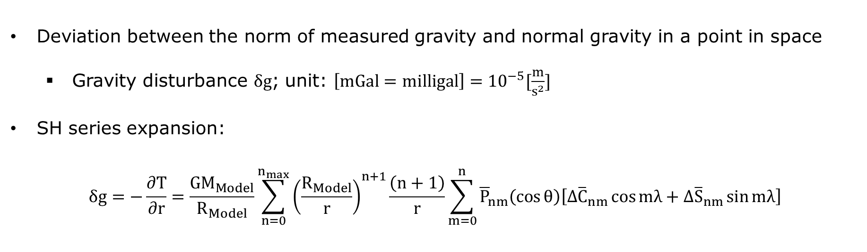
Gravity disturbances
Deviation between the norm of measured gravity and normal gravity in a point in space
  Gravity disturbance $δg$; unit: $\left[mGal=milligal\right]={10}^{−5}[\frac{m}{s^{2}}]$
SH series expansion:
$$δg=−\frac{∂T}{∂r}=\frac{GM_{Model}}{R_{Model}}\sum_{n=0}^{n_{max}}{{\left(\frac{R_{Model}}{r}\right)}^{n+1}\frac{\left(n+1\right)}{r}\sum_{m=0}^{n}{{\overline{P}}_{nm}\left(\cos{θ}\right)\left[{∆\overline{C}}_{nm}\cos{mλ}+{∆\overline{S}}_{nm}\sin{mλ}\right]}}$$

Slide 9
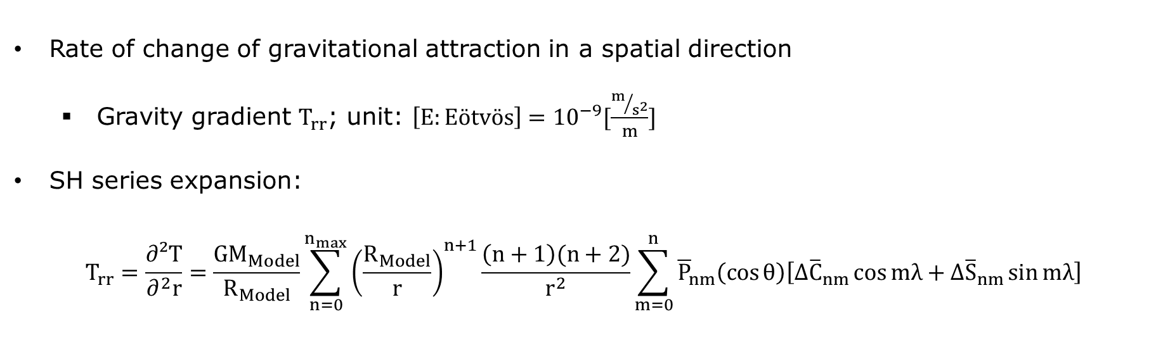
Gravity gradients
Rate of change of gravitational attraction in a spatial direction
  Gravity gradient $T_{rr}$; unit: $\left[E:Eötvös\right]={10}^{−9}[\frac{m/{s^{2}}}{m}]$
SH series expansion:
$$T_{rr}=\frac{∂²T}{∂^{2}r}=\frac{GM_{Model}}{R_{Model}}\sum_{n=0}^{n_{max}}{{\left(\frac{R_{Model}}{r}\right)}^{n+1}\frac{\left(n+1\right)(n+2)}{r^{2}}\sum_{m=0}^{n}{{\overline{P}}_{nm}\left(\cos{θ}\right)\left[{∆\overline{C}}_{nm}\cos{mλ}+{∆\overline{S}}_{nm}\sin{mλ}\right]}}$$

Slide 10
Lab 1 – Goals
Become acquainted with different gravity functionals
Understand the impact of the degree of expansion
Understand the impact of observation altitude
Understand (roughly) the scale of the static gravity signal and its temporal variations

Slide 11
Lab 1 Walkthrough – Task 1 (1)
Read gravity field model ITSG-GRACE2018s
  See “readicgem” function
Generate disturbing potential coefficients by subtracting the GRS80 normal potential
  See “reduce_normpot_grs80” function

Slide 12




Lab 1 Walkthrough – Task 1 (2)
SH coefficients format
„SC-format“
„CS-format“
degree n
0
0
$$S_{nm}$$
degree n
degree n
order m
$$S_{nm}$$
$$C_{nm}$$
$$C_{nm}$$
order m
order m
order m

Slide 13
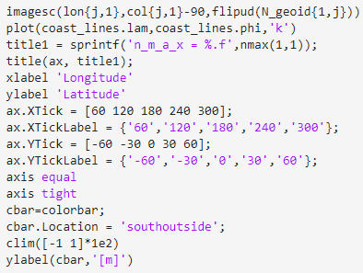
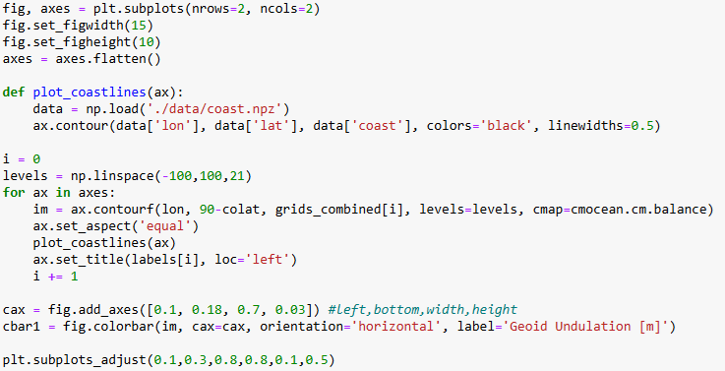
Lab 1 Walkthrough – Task 2
Compute global geoid heights up to various maximum harmonic degrees
  See “shs” function
Plot (with coastlines!) and interpret your results
longitude & colatitude (parameters of shs)
lon=[0:360]°; col=[0:180]°
global grid (output of shs)
coastlines
(coast30.mat coast.npz)

Slide 14
Lab 1 Walkthrough – Task 3
Compute and visualize global grids of gravity disturbances and vertical gravity gradients up to various maximum harmonic degrees (analogously to task 2)
  See “shs” function
How does the spatial signal change for each of the investigated gravity functionals? Why?
  See SH series expansion equations…

Slide 15
Lab 1 Walkthrough – Task 4
How does the observable gravity signal change with increasing altitude? Compute and visualize gravity disturbances as seen from various satellite altitudes
  See “shs” function
  Based on your findings so far, which conclusions regarding altitude and observation technique can be drawn for a real gravity field mission?

Slide 16
Lab 1 Walkthrough – Task 5
Import the gravity field model of April 2004 and visualize the corresponding geoid heights. Can you visually recognize any differences to the static model’s geoid heights?
Visualize this model’s deviation to the long-term mean (= static model). Do you notice anything specific about the signal’s behaviour?
  Generate model differences on coefficients level!

Slide 17
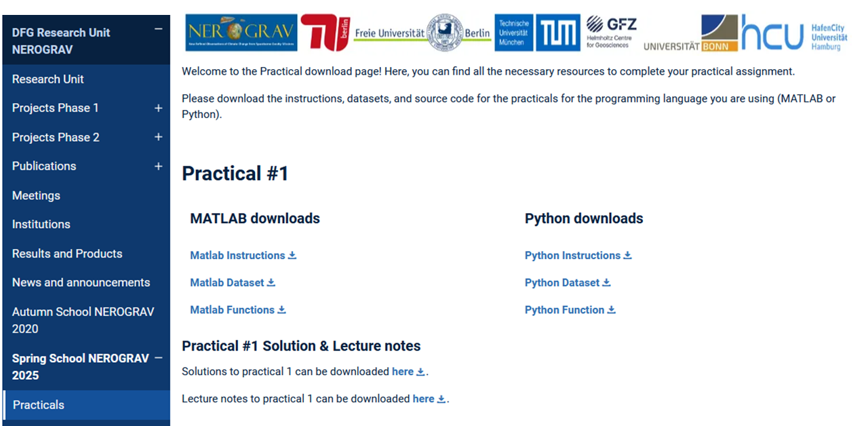
Access to Practical Material
Instructions, Data, and Source Code are available on the Spring school website
https://www.asg.ed.tum.de/iapg/nerograv/spring-school/practicals/

Slide 18


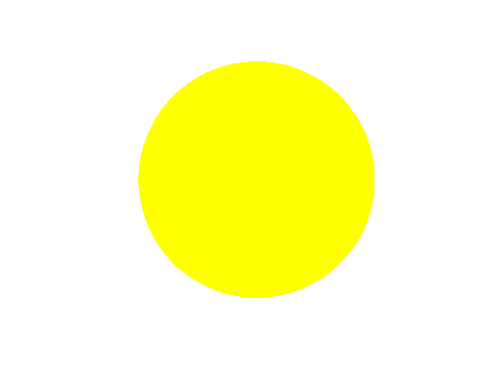
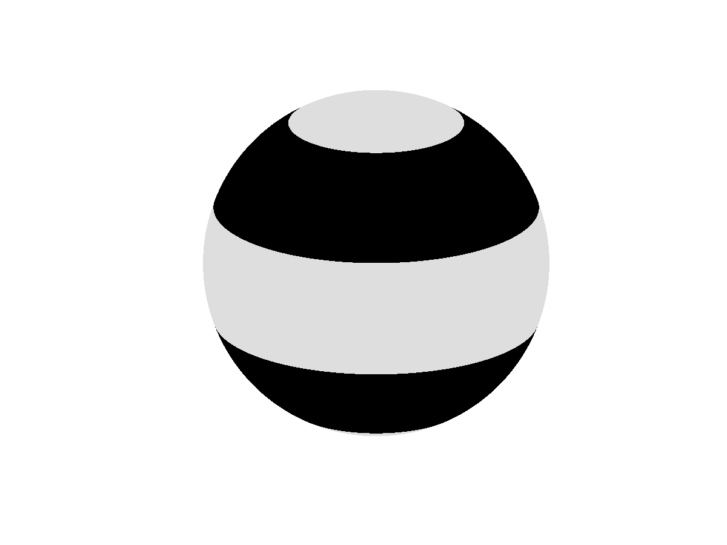
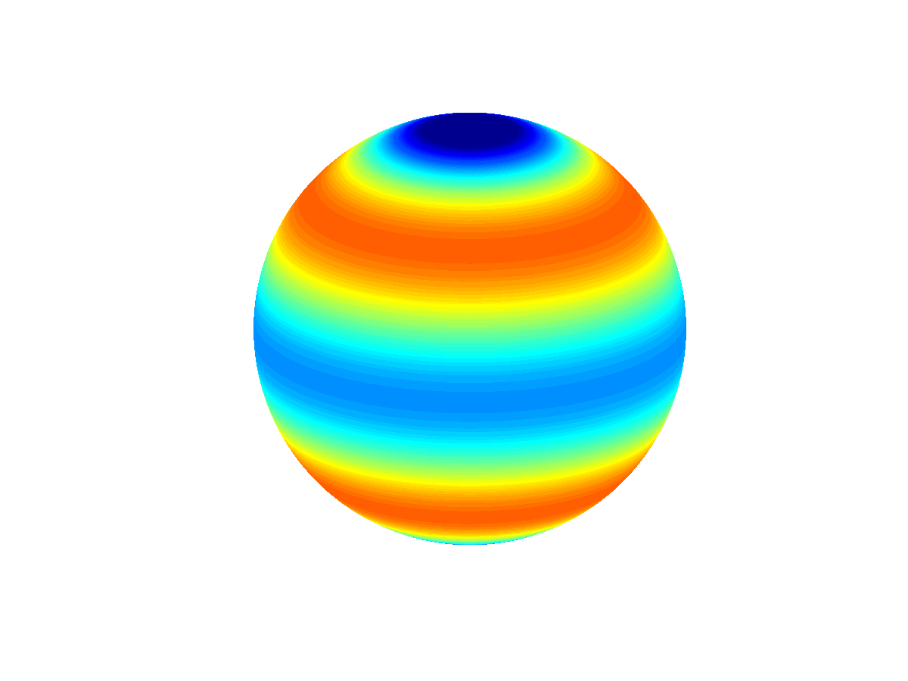
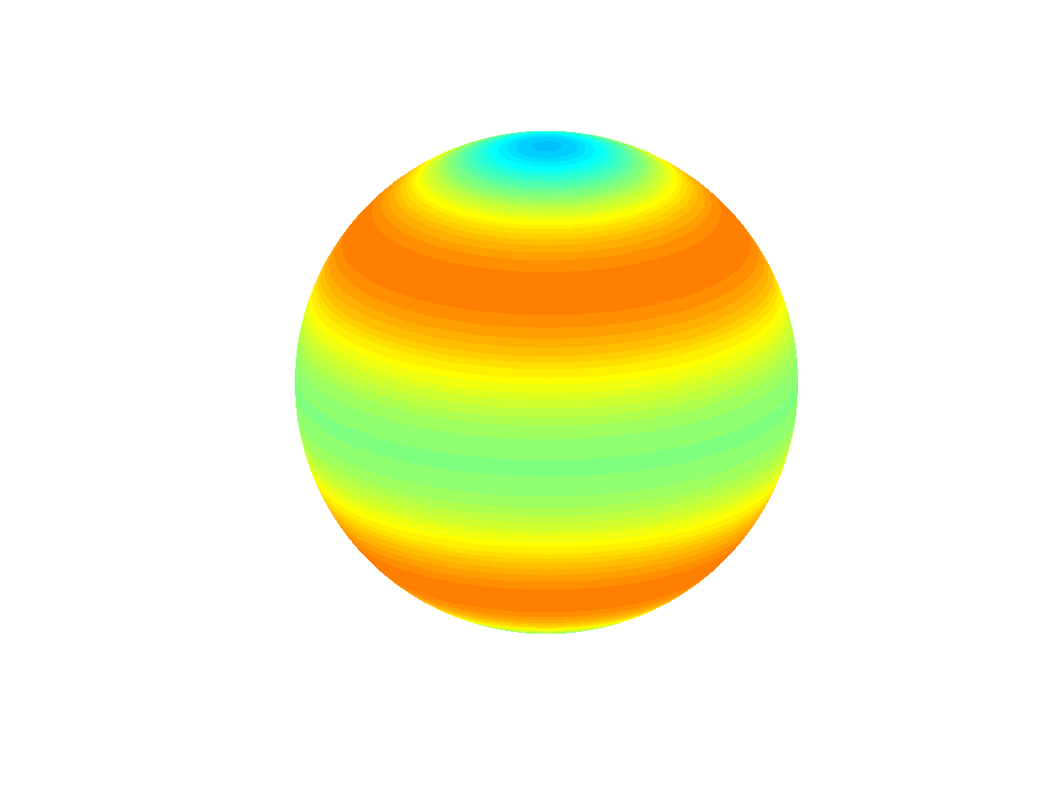

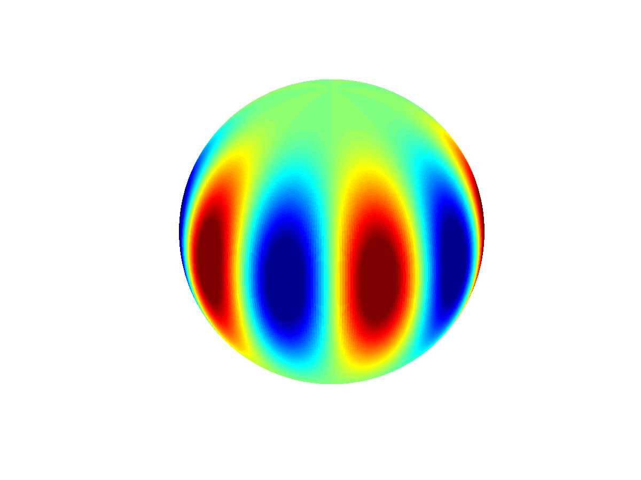
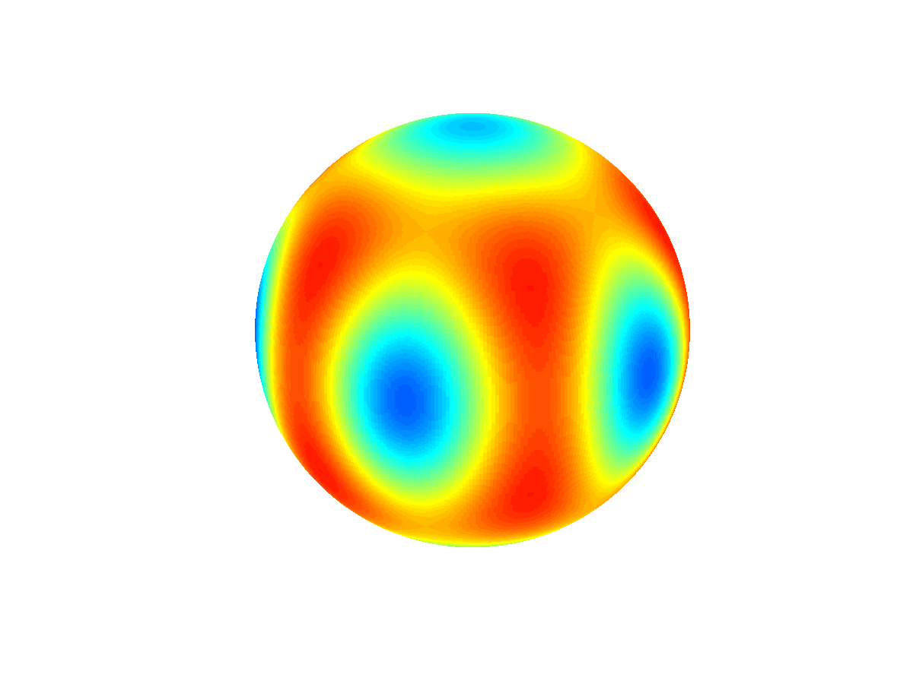
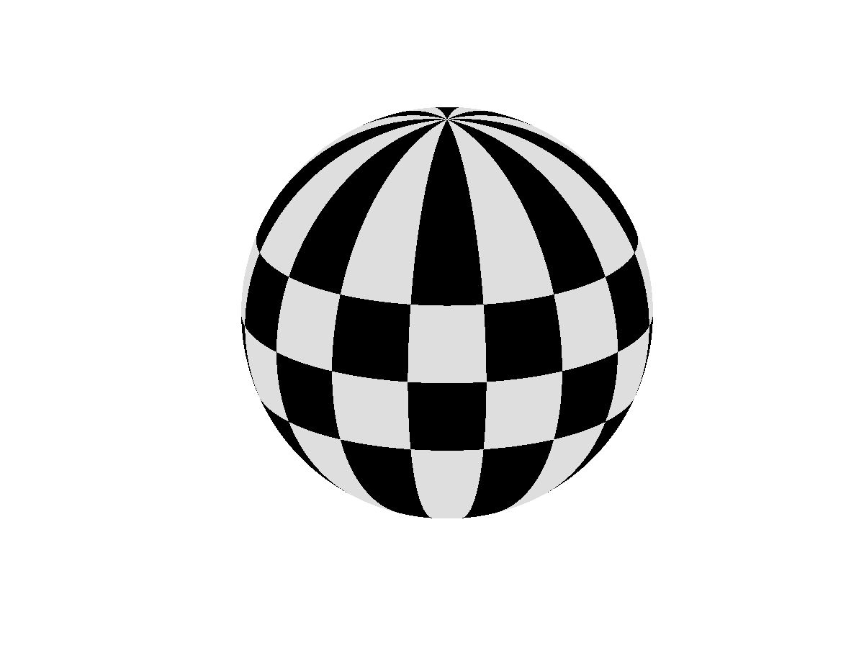
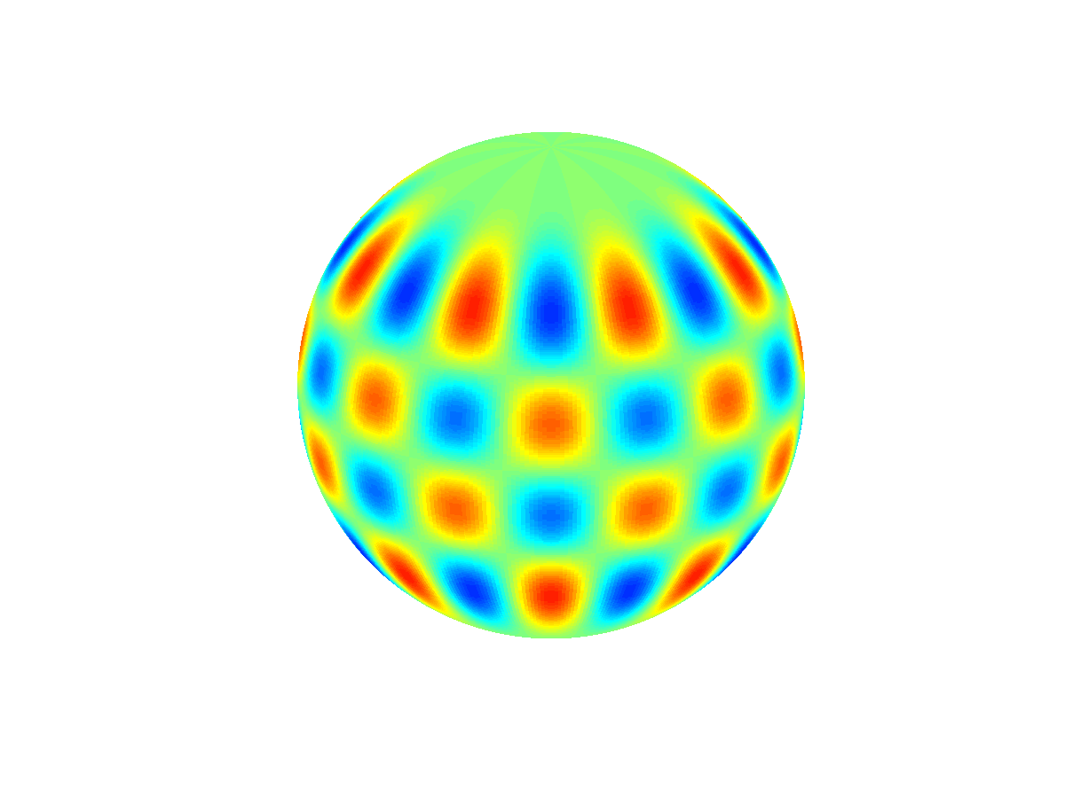
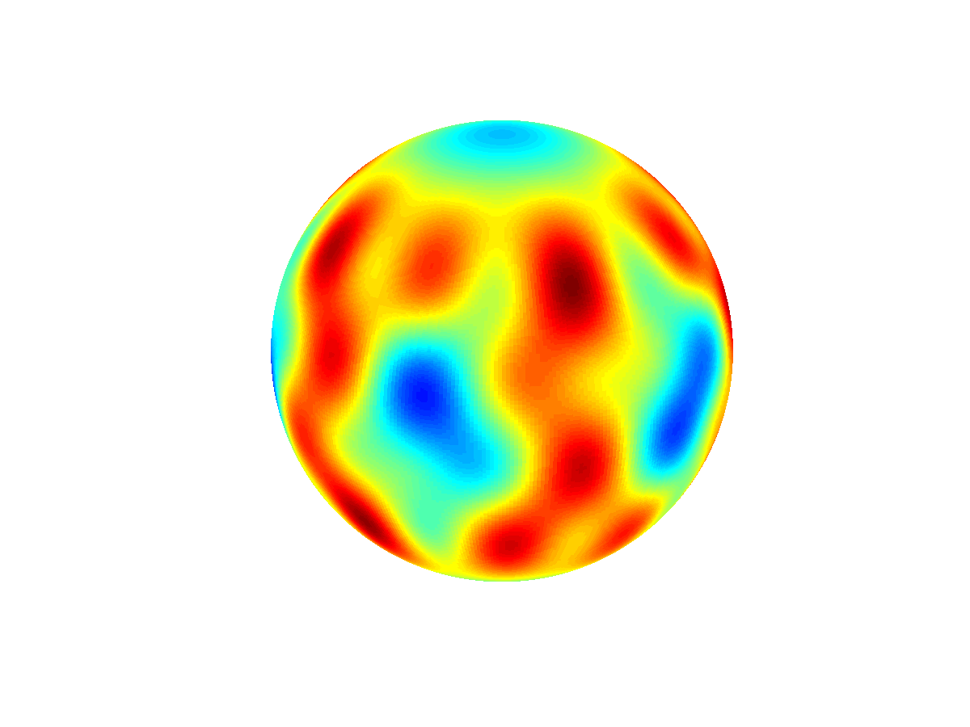
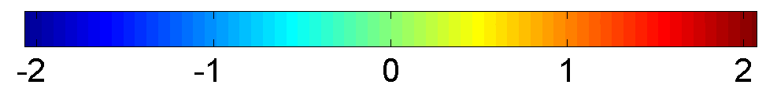
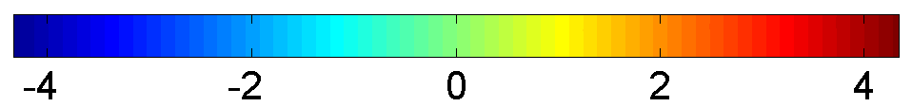
Appendix (1)
+
=
mean
+
-
=
+
zonal
+
=
sectorial
+
=
tesseral

Slide 19

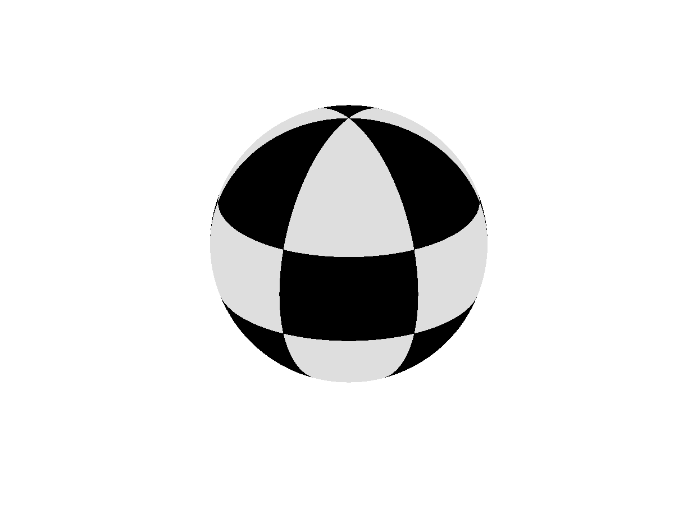
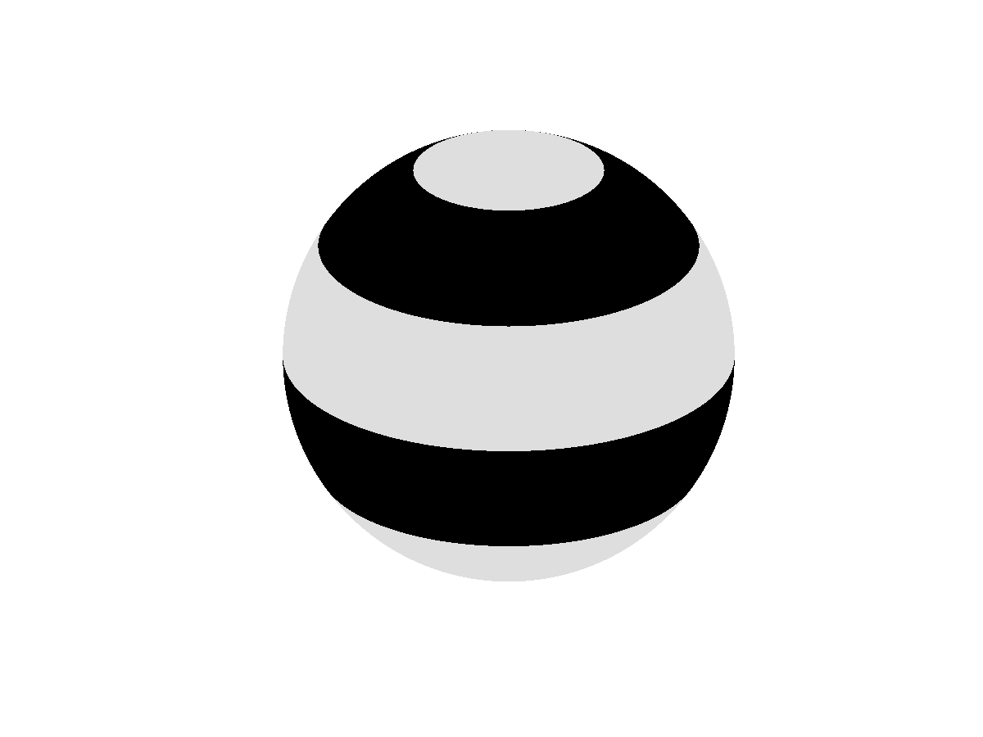
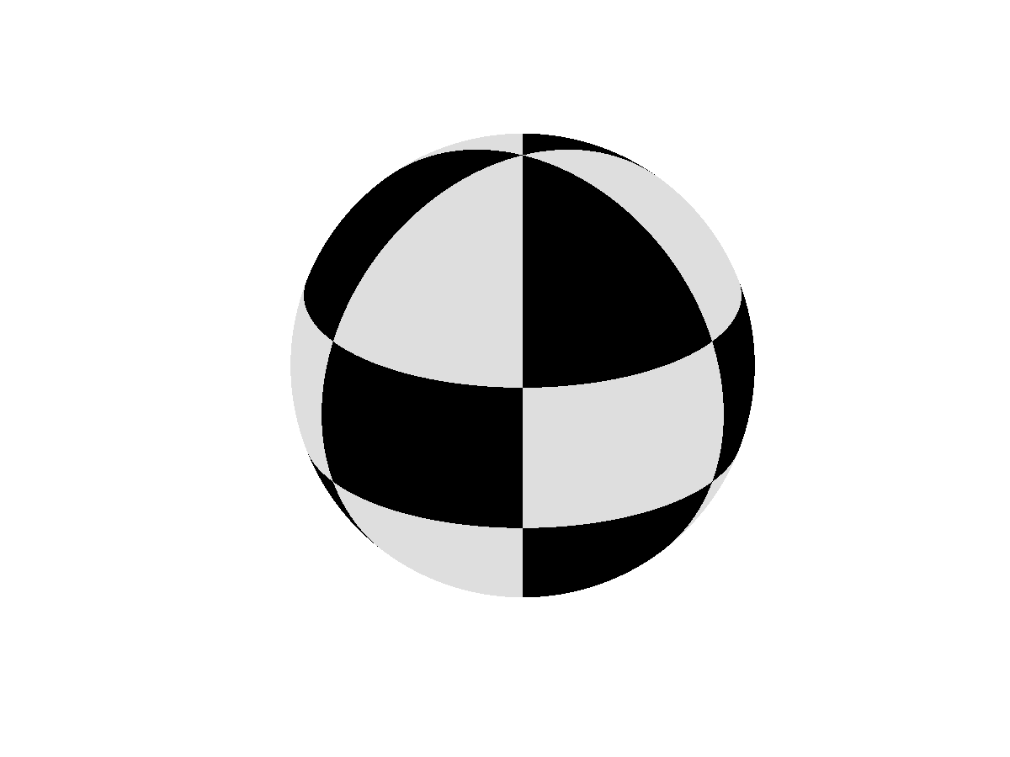

Appendix (2)
order m
C₀₀
order m
S₁₁
C₁₀
C₁₁
S₂₂
S₂₁
C₂₀
C₂₁
C₂₂
degree n
S₃₃
S₃₂
S₃₁
C₃₀
C₃₁
C₃₂
C₃₃
S₄₄
S₄₃
S₄₂
S₄₁
C₄₀
C₄₁
C₄₂
C₄₃
C₄₄
S₅₅
S₅₄
S₅₃
S₅₂
S₅₁
C₅₀
C₅₁
C₅₂
C₅₃
C₅₄
C₅₅
sectorial
tesseral
zonal
tesseral
sectorial
…
…
…
…

