Slide 1
International Spring School
Neustadt an der Weinstraße, Germany, March 10-14, 2025
Lab 2: Filtering/De-striping
Marius Schlaak (TUM) & Grigorios Kalimeris (TUM)

Slide 2
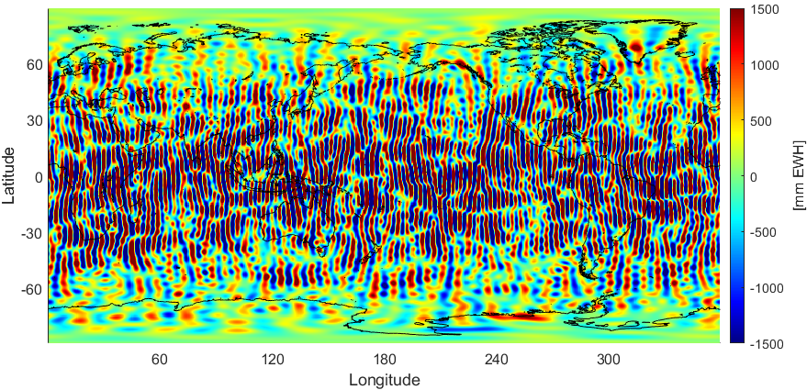
Temporal aliasing
Main cause for temporal aliasing: high-frequency, high amplitude signals originating from non-tidal atmosphere/ocean and ocean tides
Reduction is attempted by introducing background models
Nevertheless, striping still occurs due to discrepancies between models and the “true” world
Unfiltered monthly variations
unit [mm EWH]
EWH : Equivalent Water Height
More information in the next slides!

Slide 3
De-striping of temporal fields
GRACE-typical “striping” induced by temporal aliasing (mostly) superimposes all hydrological signals
How can one reduce the striping in order to reveal the hydrological signal?
Filtering!
A wide range of filters is available for this purpose
Gaussian filter (Gaussian window with different filter radii)
Swenson-Wahr decorrelation filter
DDK (different filter strengths; DDK1 (strongest) – DDK8 (weakest))
Wiener optimal filtering
VADER filter
…
! Combination of filters possible

Slide 4
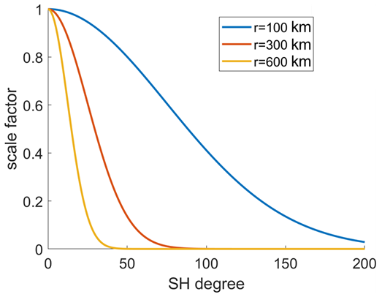
Gaussian filter (1)
Isotropic filter
Applies degree-dependent weighting of SH coefficients
Filter strength is proportional to filter radius

Slide 5
Gaussian filter (2)
Example: Gaussian 500 km (Filter radius = 500 km)

Slide 6
Swenson-Wahr decorrelation filter
Anisotropic filter
Empirical approach (a-priori assumptions on error behaviour)
Attempts to remove order-wise correlations within SH coefficients

Slide 7
DDK filter
Anisotropic filter
Combines empirical assumptions (concerning observation geometry) with actual data-based covariance information (block-wise correlations within a SH order)
Example: DDK8 (weakest)

Slide 8
Global surface density (1)
Mass per unit area on the Earth’s surface
Global surface density $∆κ$; unit: $\left[\text{kg}\text{/}\text{m}\text{²}\right]$
SH series expansion:
Alternative representation of $∆κ$ is the equivalent water height (EWH)
Central Assumption: Mass variations are caused solely by changes in water storage on the Earth’s surface
Used to describe temporal (e.g. monthly) variations within the Earth’s hydrology
Coefficient differences
(reference vs examined model)!
$$∆κ=\frac{M}{4π{R^{2}}_{Model}}\sum_{n=0}^{n_{max}}{\frac{2n+1}{1+k_{n}^{′}}\sum_{m=0}^{n}{{\overline{P}}_{nm}\left(\cos{θ}\right)\left[{∆\overline{C}}_{nm}\cos{mλ}+{∆\overline{S}}_{nm}\sin{mλ}\right]}}$$
load Love numbers (elastic Earth)

Slide 9
Global surface density (2)
How much water mass gain/loss is required to cause the corresponding change in the gravity field?
Assume a 1 kg water cuboid with 1 m² base on a grid point:
$$ρ_{Water}=\frac{M_{Water_cuboid}}{V_{Water_cuboid}}=\frac{M_{Water_cuboid}}{A∙x}\underset{⇒}{ρ_{Water}=1000{kg}/{m^{3}}}x=\frac{1{kg}/{m²}}{1000{kg}/{m^{3}}}=0.001 m=1 mm$$
1 kg/m² corresponds to 1 mm EWH!
Alternative representation of $∆κ$ are the equivalent water heights (EWHs)
A = 1 m²
which “x” yields 1 kg/m²?
x
Water cuboid
1 m
1 m

Slide 10
Lab 2 – Walkthrough
Read and visualize a synthetic “true” monthly model as well as the same model superimposed by typical GRACE noise in terms of EWH
Apply different filters (or combinations of filters) to the noise-polluted model. Which approach yields an optimal result?
Compare with true signal!
Repeat these tasks for real monthly GRACE solutions.
No true signal available for comparison…

Slide 11
Access to Practical Material
Instructions, Data, and Source Code are available on the Spring school website
https://www.asg.ed.tum.de/iapg/nerograv/spring-school/practicals/

Slide 12
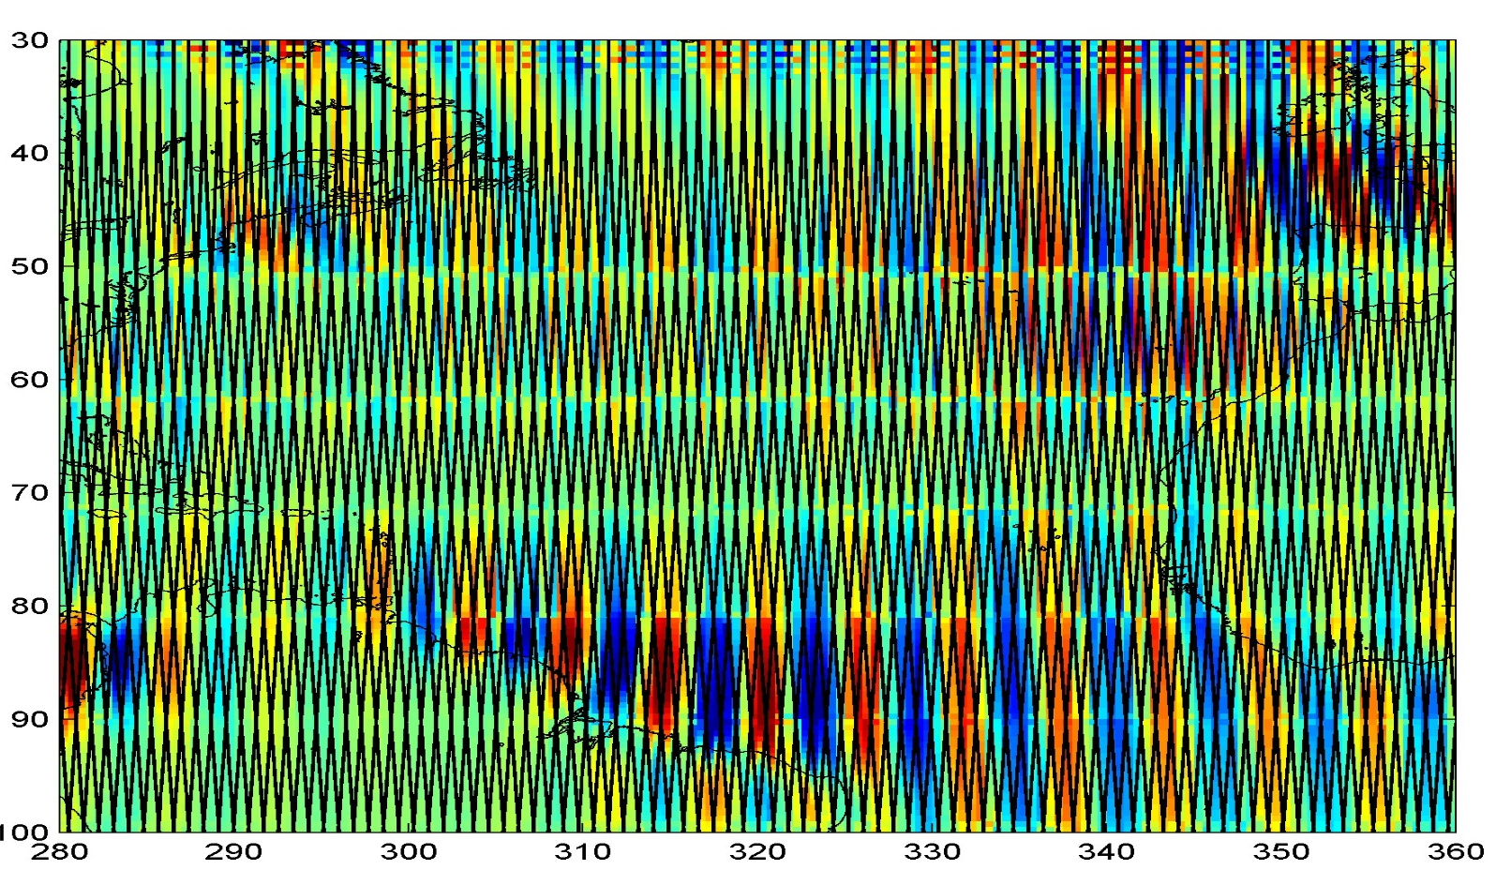
Appendix (1)
Undersampling of observed signal will result in erroneous reconstruction…

